Slide 1



SEMEVAL-2026 TASK 13
GROUP 18

Slide 2
INTRODUCTION

Slide 3


INTRODUCTION
Large language models are increasingly used in the software industry
Machine generated source code is now common in real world development
This trend raises the need for reliable detection of machine generated code

Slide 4
PROBLEM STATEMENT
The task focuses on distinguishing human written code from machine generated code
Addressed as a binary classification problem / human-written (0) and machine-generated (1)
Studied under SemEval 2026 Task 13, Subtask A: Detecting Machine-Generated Code with Multiple Programming Languages, Generators, and Application Scenarios
Training Languages: C++, Python, Java
Training Domain: Algorithmic

Slide 5


PROPOSED APPROACH OVERVIEW
Combination of traditional machine learning and neural approaches
Use of both feature based and transformer based models
Goal is to capture semantic characteristics of source code

Slide 6
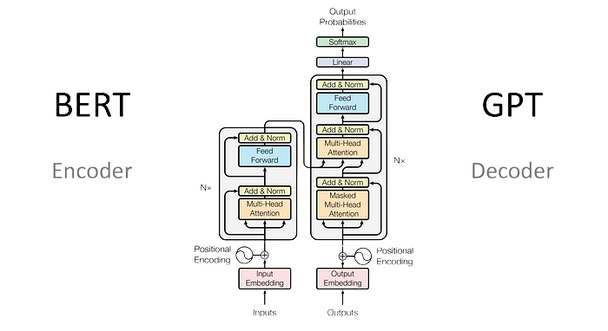

MODELS CONSIDERED
CatBoost baseline with handcrafted statistical features
Encoder based transformer models fine tuned for code semantics
CodeBERT
UniXcoder
ModernBERT
source

Slide 7
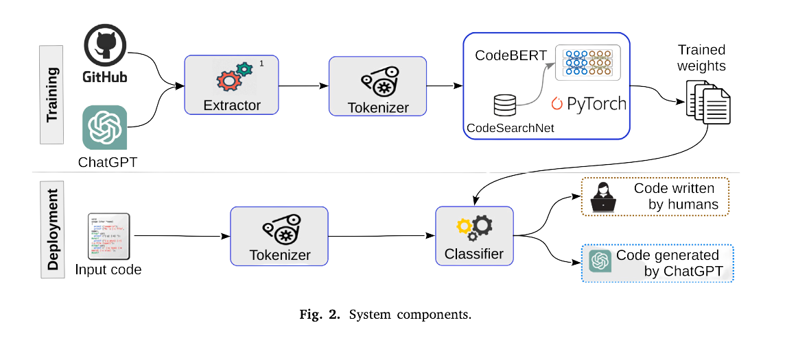
PREPROCESSING MOTIVATION
Surface level artifacts can bias detection models
GPTSniffer inspired preprocessing techniques are applied
Encourages learning deeper semantic patterns rather than stylistic cues
GPTSniffer (Nguyen et al., 2024)

Slide 8
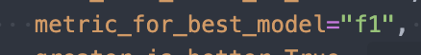
EVALUATION SETUP
Experiments conducted on the official SemEval 2026 Task 13 Subtask A dataset
Macro F1 score used as the primary evaluation metric
Ensures fair comparison across all models

Slide 9

KEY MESSAGE OF THE INTRODUCTION
Detecting machine generated code is a challenging problem
Multiple modeling strategies are required for robust analysis
Comparable model performance highlights generalization difficulty

Slide 10
SMALL EDA AND SUMMARY OF MILESTONE

Slide 11
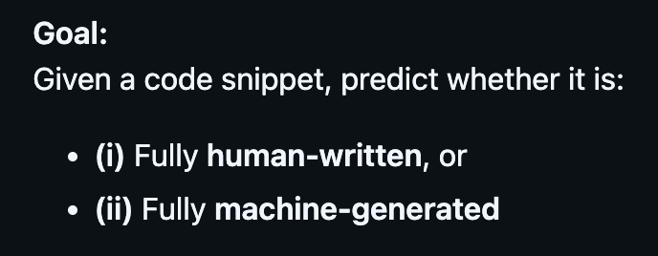
TASK OVERVIEW
This work addresses SemEval 2026 Task 13, Subtask A
The task is binary classification of source code
Label 0 represents human authored code
Label 1 represents machine generated code

Slide 12

WHY THIS TASK MATTERS
Large language models are widely used for code generation
Automatically generated code is increasingly present in real world systems
Reliable detection is important for robustness, security, and evaluation
The task emphasizes generalization beyond known generators

Slide 13
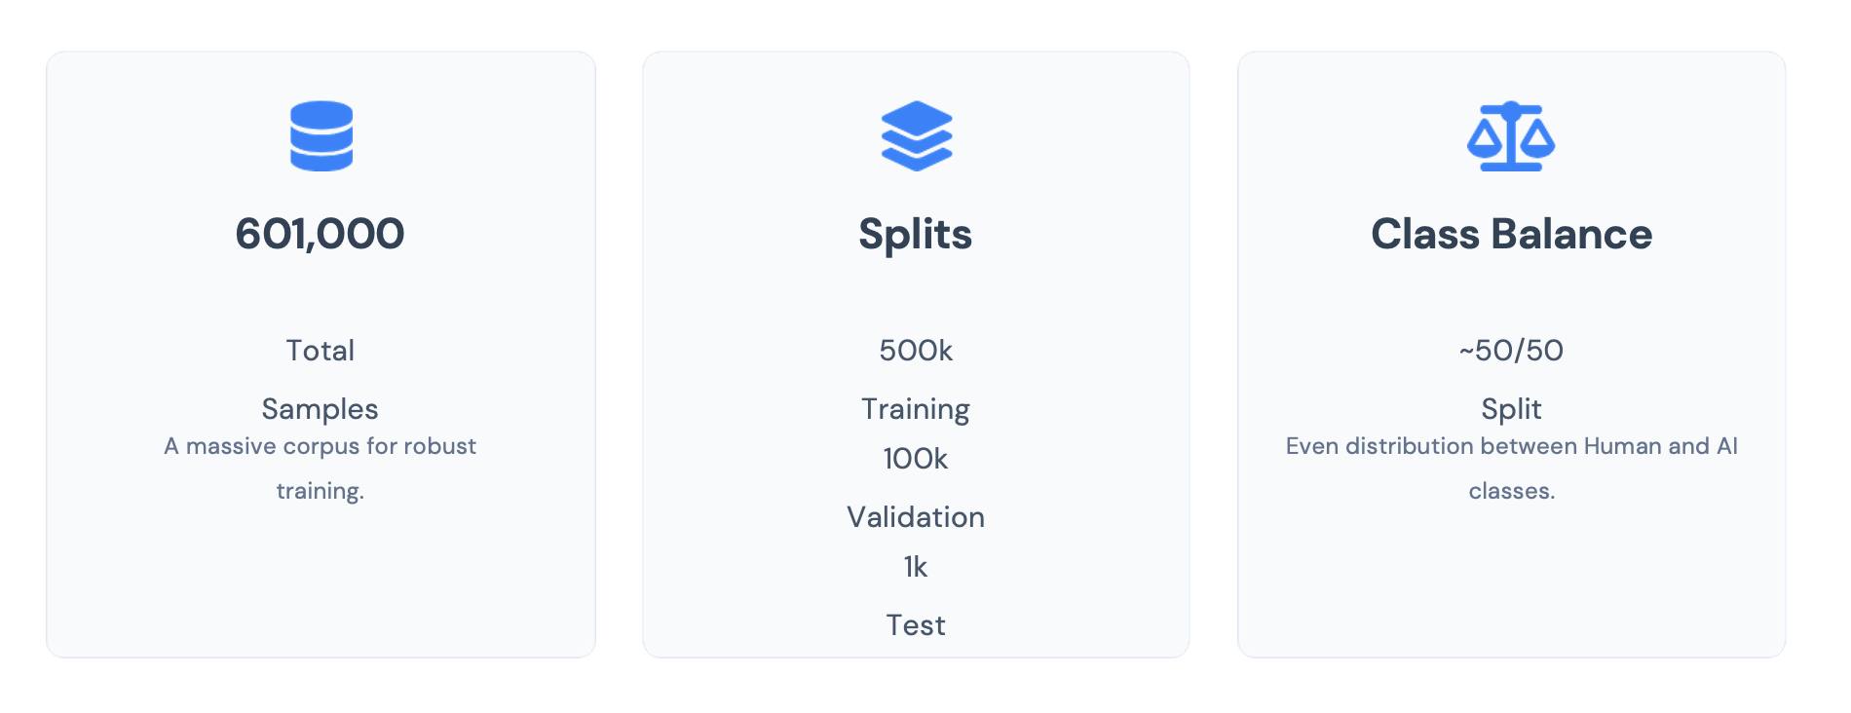
DATASET OVERVIEW

Slide 14
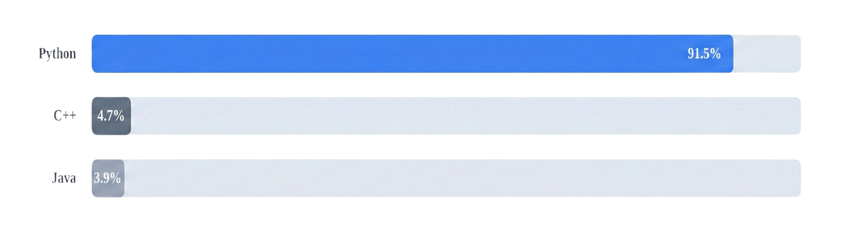
LANGUAGE DISTRIBUTION
Strong imbalance across programming languages

Slide 15
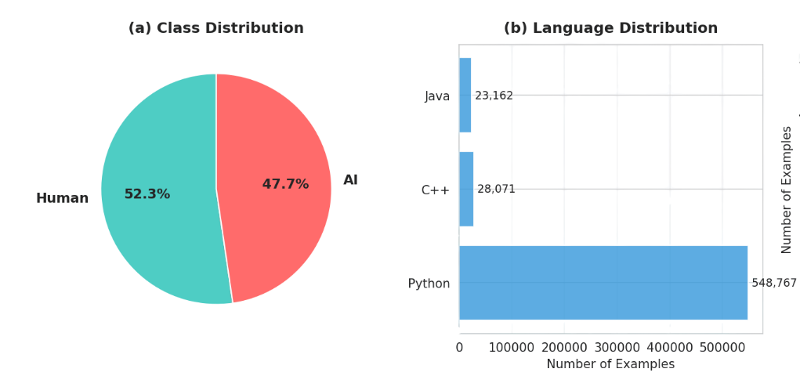
KEY EDA INSIGHT
Although label distribution is balanced
Programming language distribution is highly skewed
Models may overfit to Python specific patterns
Generalization to low resource languages is a major challenge

Slide 16
METRIC CHOICE MOTIVATION
Accuracy alone is not sufficient due to language imbalance
Macro F1 score is selected as the primary metric
Ensures equal importance for all classes and languages
Encourages robustness across underrepresented languages

Slide 17
IMPLICATIONS FOR MODELING
Surface level cues may dominate due to language skew
Models must learn semantic and structural patterns
Preprocessing and masking are critical to reduce bias
Evaluation must consider distribution shift explicitly

Slide 18
SUMMARY OF EDA FINDINGS
Dataset is large and balanced at the label level
Severe imbalance exists at the language level
Python centric bias is a core difficulty of the task
These findings directly motivate our modeling and preprocessing choices

Slide 19
RELATED
WORK

Slide 20


RELATED WORK OVERVIEW
With the increasing adoption of AI systems, research on machine-generated code detection has grown rapidly in recent years
Existing studies explore both feature based and neural approaches
Focus is on improving robustness across generators and languages

Slide 21
GPTSNIFFER (NGUYEN ET AL., 2024)
Detects whether a code snippet is written by ChatGPT or humans
Built on CodeBERT
Architecture consists of three components: Extractor, Tokenizer, Classifier
Shows that aggressive preprocessing, removing surface-level artifacts (e.g., comments, package names), improves performance
Demonstrates CodeBERT’s effectiveness in using semantic information for code classification

Slide 22
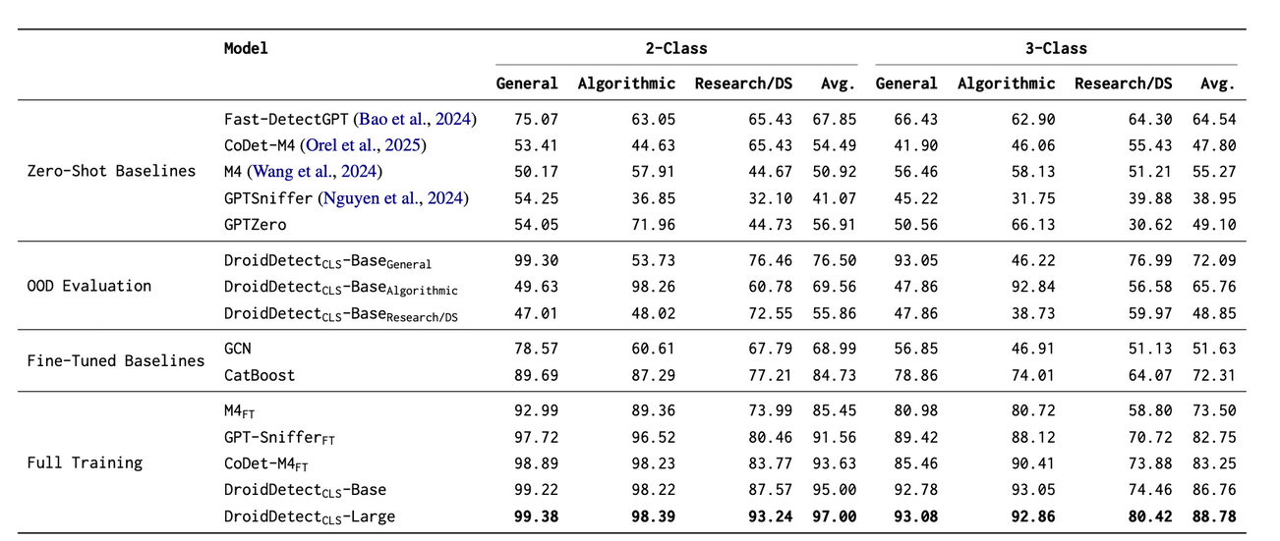
DROID (OREL, PAUL, ET AL., 2025)
Introduces multi-way classification data for AI-generated code detection
Releases DroidDetect-Base and DroidDetect-Large
- Fine-tuned from ModernBERT
Evaluates multiple detectors:
- GPTSniffer, CoDet-M4, GPT-Zero, Fast-DetectGPT, M4 classifier
Trains models
- Graph Convolutional Network (GCN)
- CatBoost classifier
- Encoder-only transformers (outperform all baselines)

Slide 23
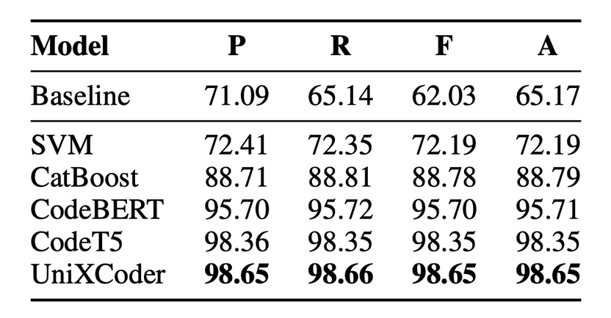
CODET-M4 (OREL, AZIZOV, & NAKOV, 2025)
Uses both traditional machine learning approaches (SVM and CatBoost) and DNNs (CodeBERT, UniXcoder, CodeT5) to identify LLM-generated code
Key findings:
Models can almost perfectly detect LLM-generated code
DNN-based models are more consistent across programming languages
DNNs effectively capture hidden stylistic and structural characteristics unique to each LLM
LLM code is more structured (empty lines, more assignments operations)

Slide 24
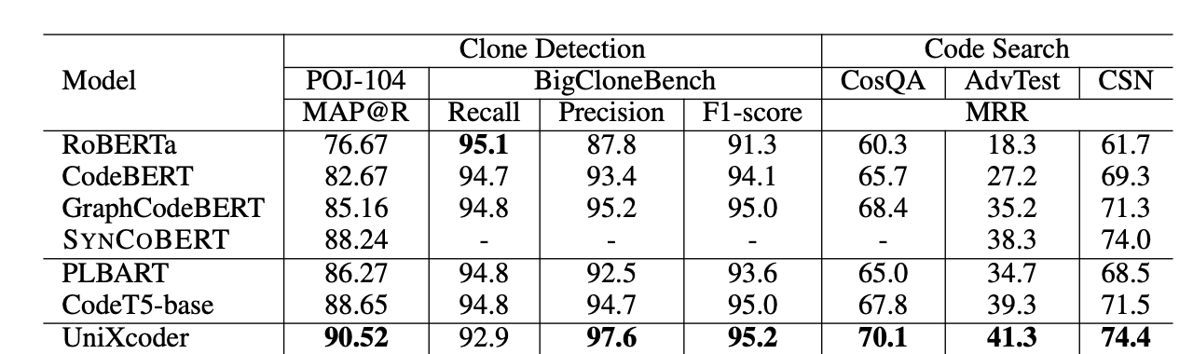
UNIXCODER (GUO ET AL., 2022)
Presents UniXcoder, a unified cross-modal pre-trained model for programming languages
Leverages multi-modal contents to enhance code representation
- Code comment
- Abstract syntax tree (AST)
Evaluates UniXcoder on five tasks: clone detection, code search, code summarization, code generation, and code completion
Achieves state-of-the-art performance on understanding tasks
Significantly outperforms previous works on most tasks

Slide 25
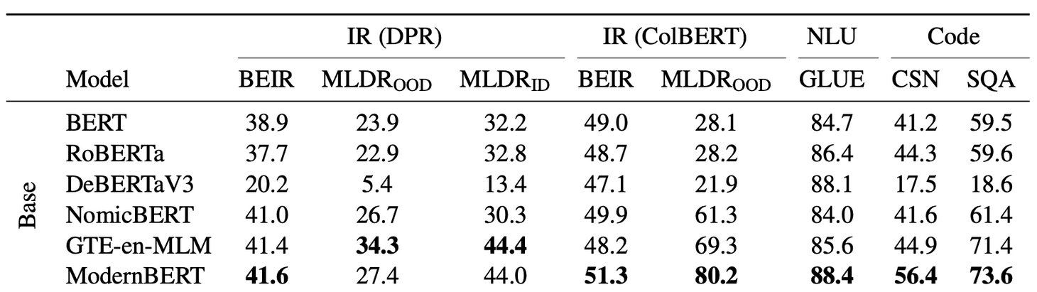
MODERNBERT (WARNER ET AL., 2025)
Introduces ModernBERT, a modernized encoder-only transformer model
Pre-trained on code and uses a code-aware tokenizer
Releases ModernBERT-base and ModernBERT-large
- Achieve state-of-the-art performance among encoder models
Outperforms existing encoders on:
- BEIR (Information Retrieval)
- GLUE (Natural Language Understanding)
ModernBERT is the most efficient encoder model in terms of tokens-per-second efficiency

Slide 26
KEY TAKEAWAYS FROM PRIOR WORK
Both feature based and transformer models are effective for machine-generated code detection
Semantic focused preprocessing improves robustness
Modern encoder architectures show strong results on code classification tasks

Slide 27
METHODOLOGY

Slide 28
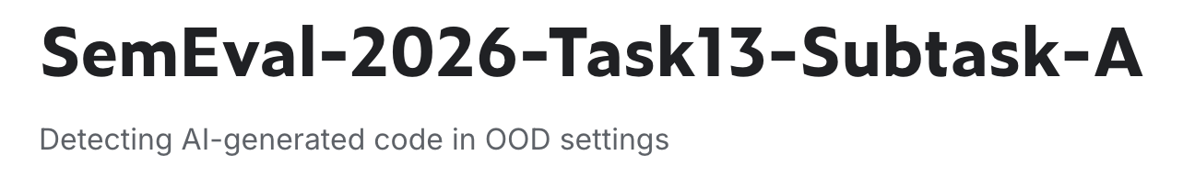
METHODOLOGY OVERVIEW
Experiments follow the official SemEval 2026 Task 13 Subtask A setup
Machine generated code detection treated as binary classification
Strict compliance with dataset and model usage rules

Slide 29
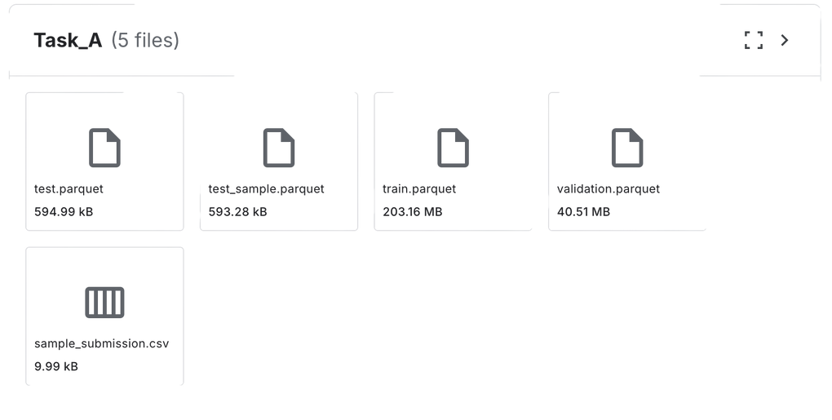
DATASET AND TASK DEFINITION
Official SemEval 2026 Task 13 Subtask A dataset used
Fixed training, validation, and test splits provided by organizers
No external datasets permitted
Enables fair comparison with prior SemEval work

Slide 30
MODELING STRATEGY
Motivation from prior work combining complementary approaches
Feature based baseline for surface level patterns
Encoder based transformers for semantic and structural modeling
Unified evaluation under a single experimental framework

Slide 31
PREPROCESSING STRATEGY
GPTSniffer inspired preprocessing applied
Removal or masking of superficial artifacts such as comments and imports
Prevents overfitting to generator specific stylistic cues
Encourages learning deeper semantic patterns

Slide 32

CATBOOST BASELINE
CatBoost used as a feature based baseline
Followed procedures similar to those described in Droid (Orel, Paul, et al., 2025) and CoDet-M4 (Orel, Azizov, & Nakov, 2025)
Aggregated all features explicitly mentioned across both papers
13 handcrafted statistical and structural features extracted
Includes metrics such as average line length, whitespace ratio, count of empty lines, comment density, average identifier length, and AST depth
AST-based features extracted using Tree-sitter parsers across languages (e.g., tree_sitter_java, tree_sitter_c)

Slide 33
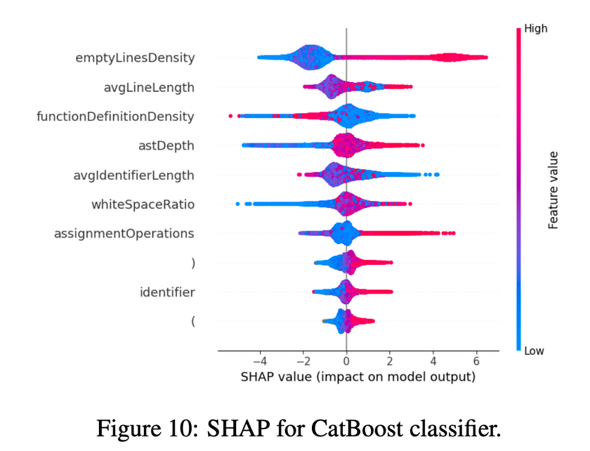
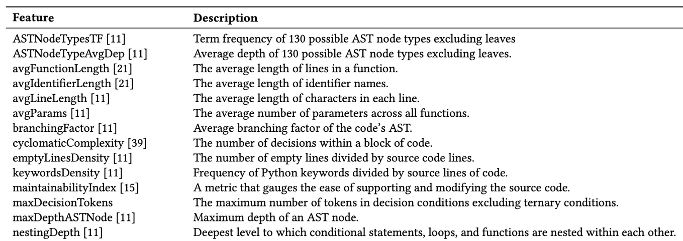
Prior work uses hundreds of handcrafted features
We select a compact, computationally feasible subset, focusing on the most influential indicators explicitly described in prior work
(Idialu et al., 2024)
(Orel, Azizov, & Nakov, 2025)

Slide 34
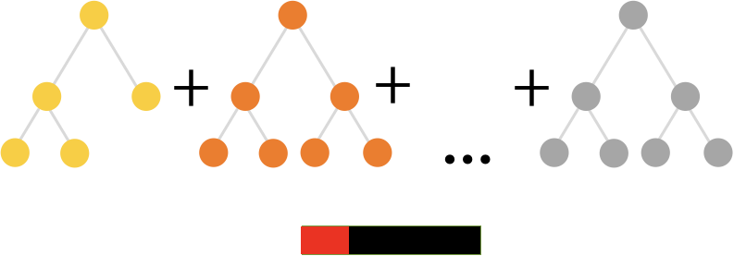
CATBOOST TRAINING DETAILS
CatBoost hyperparameters follow CoDet-M4
- 2000 trees, learning rate = 0.1, tree depth = 6
Fixed random seed for reproducibility
No exhaustive hyperparameter tuning performed
- AST-based feature extraction is computationally expensive
- Limited computational resources

Slide 35
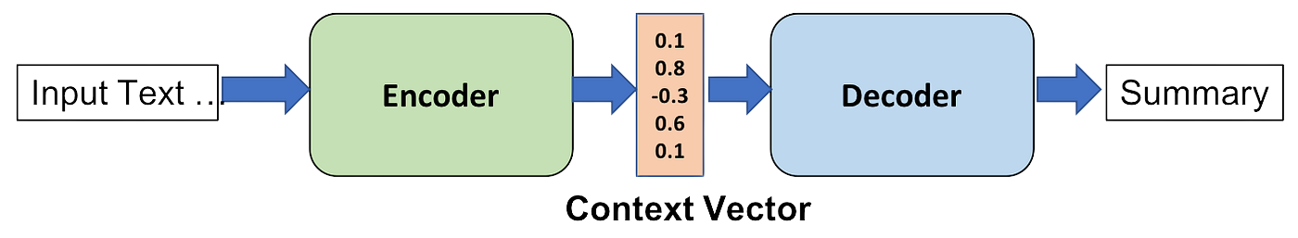
MODERNBERT MODEL
ModernBERT base used as encoder only transformer
Designed for efficient long context classification
Incorporates rotary positional embeddings and efficient attention
Well suited for code discrimination tasks
source

Slide 36
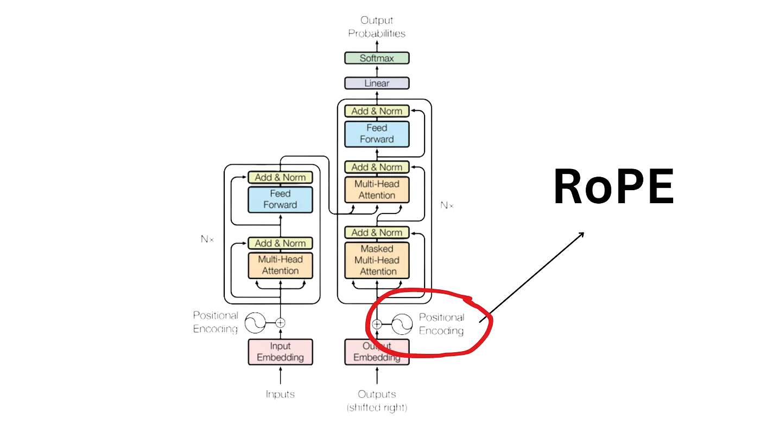
ROTARY POSITIONAL EMBEDDINGS (ROPE)
Instead of absolute position embeddings, ModernBERT encodes positional information through rotations in embedding space. This allows the model to capture long range dependencies more effectively and generalize better to longer sequences.
source

Slide 37
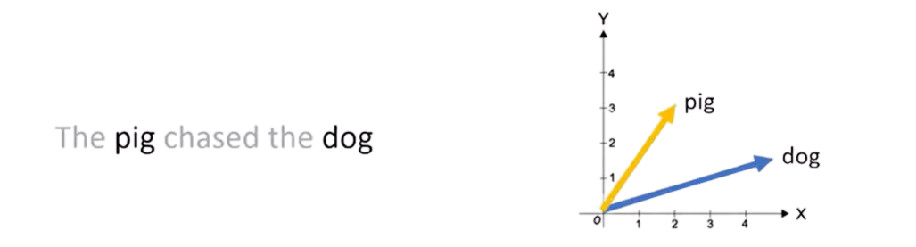
ROTARY POSITIONAL EMBEDDINGS (ROPE)
Instead of adding a position vector to a word embedding, RoPE rotates the word vector.
The rotation angle depends on the word’s position in the sequence.
Position 1 is rotated by θ, position 2 by 2θ, position 3 by 3θ, and so on.
source

Slide 38
EFFICIENT ATTENTION DESIGN
ModernBERT combines local and global attention patterns to reduce computational overhead while preserving contextual awareness. This makes it faster and more memory efficient compared to vanilla self attention.
Local attention:
Each token focuses on nearby tokens using a sliding window, capturing local structure.
Global attention:
Selected tokens can still attend to the entire sequence, preserving global context.

Slide 39
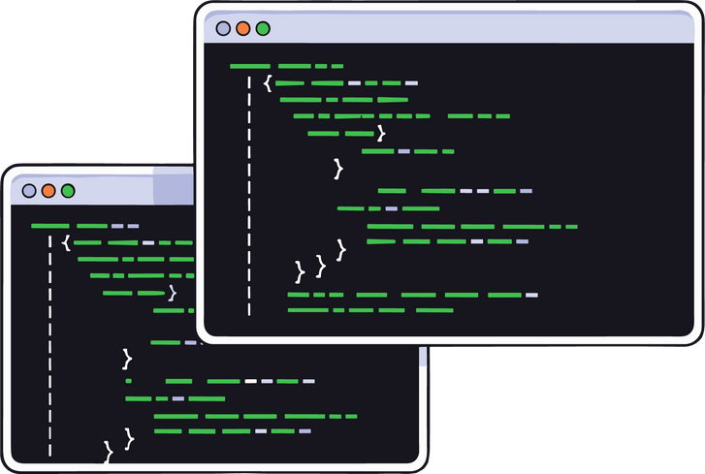

LARGE SCALE PRETRAINING
ModernBERT is pretrained on trillions of tokens from diverse sources, including natural language and code, resulting in strong general purpose representations.
MODERNBERT WAS TRAINED ON 2 TRILLION TOKENS OF DIVERSE DATA INCLUDING WEB DOCUMENTS, CODE, AND SCIENTIFIC ARTICLES

Slide 40
BERT VS MODERNBERT
BERT
Encoder based transformer designed for general language understanding
Uses absolute positional embeddings
Standard full self attention
Maximum context length of 512 tokens
ModernBERT
Encoder based transformer that modernizes the BERT architecture
Replaces absolute positions with Rotary Positional Embeddings (RoPE)
Supports much longer sequences, up to 8k tokens
Designed to better model long range dependencies

Slide 41
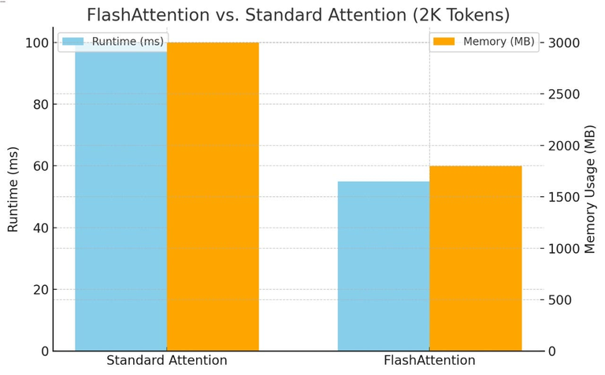
BERT VS MODERNBERT
ModernBERT
Uses optimized attention mechanisms such as Flash Attention
Combines local sliding window attention with global attention
Faster training and inference with lower memory usage
Pretrained on very large and diverse datasets, including substantial amounts of code
BERT
Uses vanilla self attention, which scales quadratically with sequence length
Higher memory and compute cost for long inputs
Pretrained mainly on natural language corpora such as Wikipedia and Books
Vanilla self attention computes and stores the full attention matrix for all token pairs, while Flash Attention computes the same result in memory efficient GPU friendly blocks
source

Slide 42
BERT VS MODERNBERT
BERT
Strong baseline encoder model
Limited context length may truncate long code snippets
Less effective at capturing long distance relations between functions and variables
ModernBERT
Can process much longer code samples without truncation
RoPE improves structural and positional reasoning in code
Better suited for discriminative tasks such as human vs machine generated code detection
Empirically achieves stronger separability and more stable performance

Slide 43
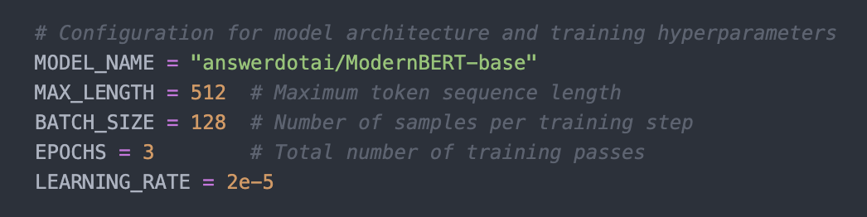
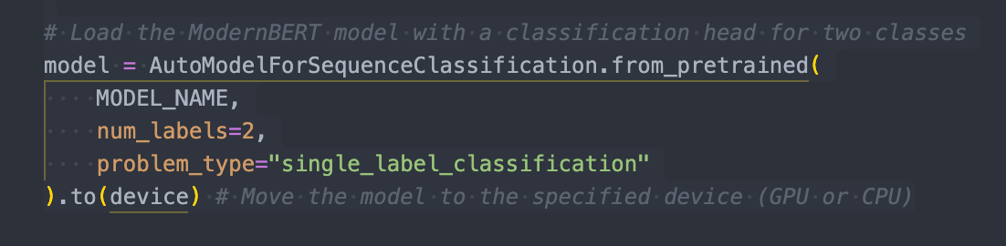
MODERNBERT TRAINING SETUP
Initialized from pretrained ModernBERT base checkpoint
Binary sequence classification head
Maximum sequence length of 512 tokens
Trained for 3 epochs with macro F1 based early stopping

Slide 44
UNIXCODER MODEL
UniXcoder used as an encoder based baseline
Pretrained on source code, ASTs, and natural language
Designed for cross language generalization
Task framed as binary sequence classification

Slide 45
UNIXCODER TRAINING AND EVALUATION
Dynamic padding applied for efficiency
Evaluated under two preprocessing configurations
Compared variable masking and comment import removal
Early stopping triggered based on validation performance, with model selection driven by macro F1

Slide 46
TF IDF LEXICAL BASELINES
Classical lexical models included as lightweight baselines
TF IDF representations capture surface level token patterns
No semantic pretraining required
Computationally efficient CPU based models

Slide 47
TF IDF MODEL CONFIGURATIONS
Multinomial Naive Bayes with unigrams and bigrams
Linear SVM with unigrams, bigrams, and trigrams
Large vocabulary sizes used to capture lexical variation
Evaluated on official validation split

Slide 48
GRAPHCODEBERT MODEL
GraphCodeBERT, a model pretrained for structural code modeling, was fine-tuned for classification.
Pretrained with data flow aware objectives
Fine tuned for binary classification
Uses raw code snippets as input

Slide 49
GRAPHCODEBERT TRAINING DETAILS
Maximum sequence length of 512 tokens
FP16 mixed precision training enabled
Best checkpoint selected based on validation accuracy
Performance reported with macro averaged metrics

Slide 50
XGBOOST CLASSIFIER
Hybrid approach combining lightweight stylistic features with traditional lexical representations.
Leverages gradient boosting on decision trees to capture non-linear interactions.
Aims to distinguish human-written from machine-generated code using both structure and vocabulary.

Slide 51
XGBOOST TRAINING CONFIGURATION
Key Hyperparameters: 2,000 estimators, Maximum depth of 8, Learning rate of 0.05
Regularization & Stopping: Subsampling rate of 0.8 for both data instances and columns per tree to prevent overfitting. Early stopping monitored on the validation set.

Slide 52
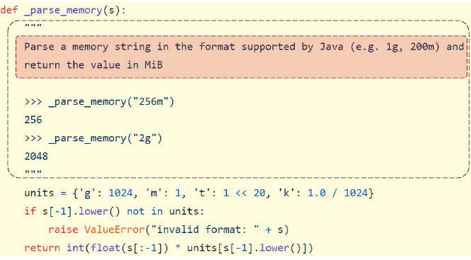
CODEBERT MODEL
CodeBERT is a CodeBERT is a bimodal model based on RoBERTa (Transformer-based) that processes both Natural Language (NL) and Programming Language (PL) Pretrained on CodeSearchNet corpus
Fine tuned for machine generated code detection
(Feng et al. 2020)

Slide 53
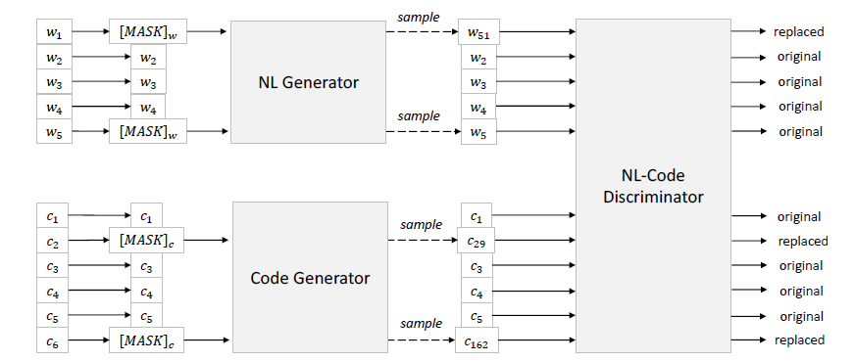
CODEBERT PRETRAINING
Architecture : Multi-layer Transformer (12 layers, 768 hidden size, 12 attention heads) – identical to RoBERTa-base.
Objective 1: Masked Language Modeling (MLM):
-Randomly masks tokens in both NL and PL parts.
-Goal: Predict the original token based on context.
-Benefit: Learns code syntax and context
Objective 2: Replaced Token Detection (RTD):
-Uses a generator to replace some tokens with plausible alternatives.
-The discriminator (CodeBERT) must detect which tokens are real and which are fake.
-Benefit: Increases efficiency and forces the model to learn fine-grained details, making it highly effective for detection tasks.
(Feng et al. 2020)

Slide 54
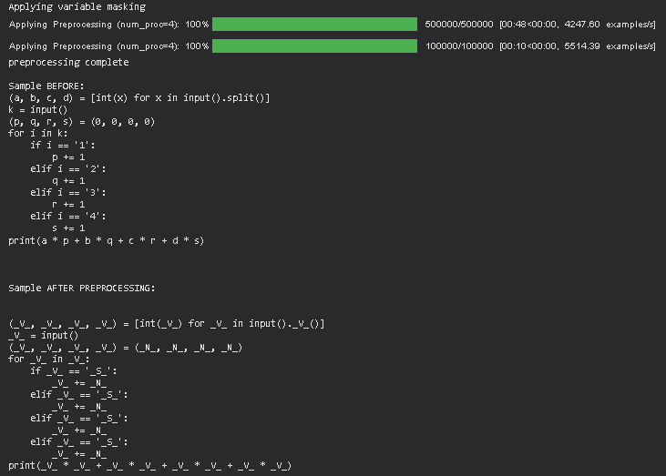
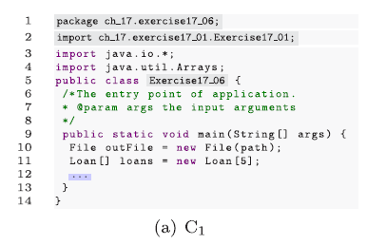
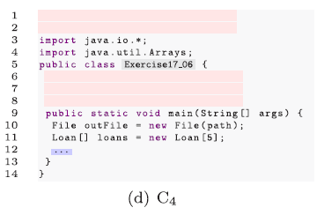
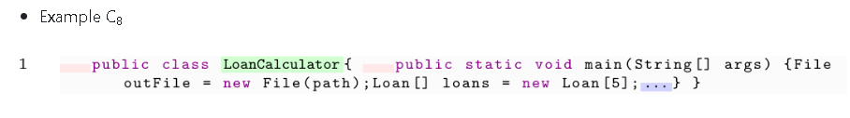
CODEBERT PREPROCESSING VARIANTS
C8 configuration removes all non-executable text and hints that would help model to identify author(keeps variable names, function names and control flow)
C4 configuration only removes natural language(comments and docstrings
Our novel masking approaches only keeps language specific keywords and masks variable names, strings and numbers to force model capture underlying logic
Nguyen et al. 2024

Slide 55
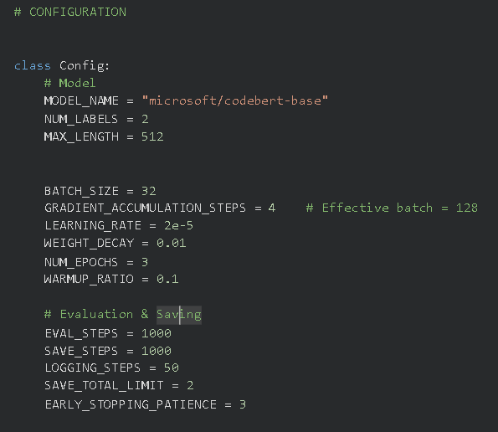
CODEBERT TRAINING SETUP
Implementation Framework:
Library: Hugging Face Transformers (Trainer API) + PyTorch.
Base Model: microsoft/codebert-base (125M parameters).
Precision: FP16 (Mixed Precision) utilized to optimize memory on the A100 GPU.
Hyperparameters :
-Learning Rate: 2e-5 (Standard for fine-tuning BERT-based models).
-Effective Batch Size: 128
-Sequence Length: Truncated to 512 tokens (obtained by EDA).
Optimization:
-Optimizer: AdamW with linear weight decay.
-Regularization: Early Stopping (Patience = 3) to prevent overfitting.

Slide 56
METHODOLOGY SUMMARY
Multiple complementary modeling approaches evaluated
Strong emphasis on fairness and reproducibility
Unified SemEval compliant experimental setup
Enables systematic comparison of feature based and neural methods

Slide 57
RESULTS

Slide 58
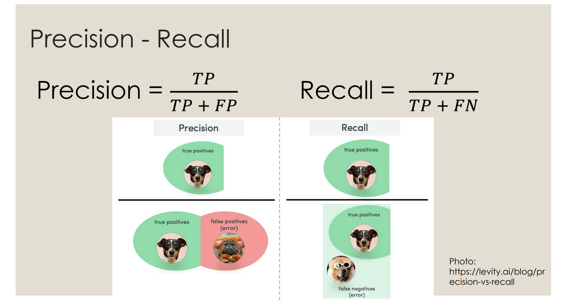
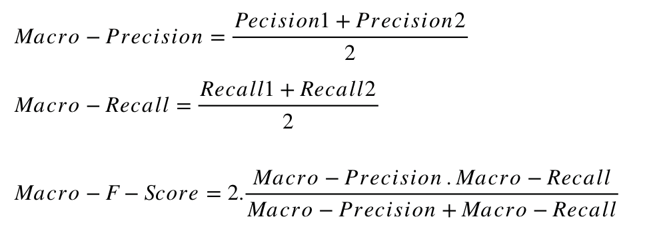
RESULTS OVERVIEW
Evaluation conducted on validation and hidden test sets
Performance measured using macro F1, precision, and recall
Strong contrast observed between in distribution and out of distribution results
source
source

Slide 59
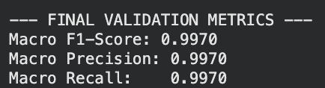
MODERNBERT VALIDATION PERFORMANCE
Macro F1 score of 0.997 on the validation set
Macro precision and recall both equal to 0.997
Indicates highly balanced classification across both classes

Slide 60
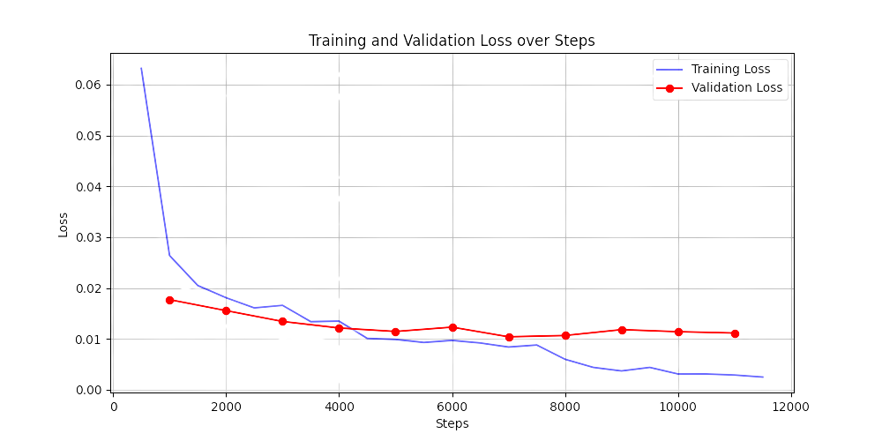
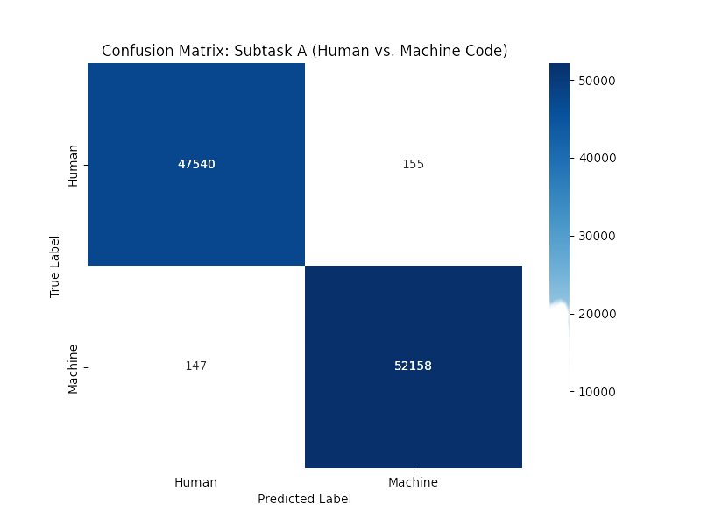
MODERNBERT TRAINING BEHAVIOR
Training and validation losses decrease consistently
No visible signs of overfitting
Confusion matrix shows only negligible misclassifications

Slide 61
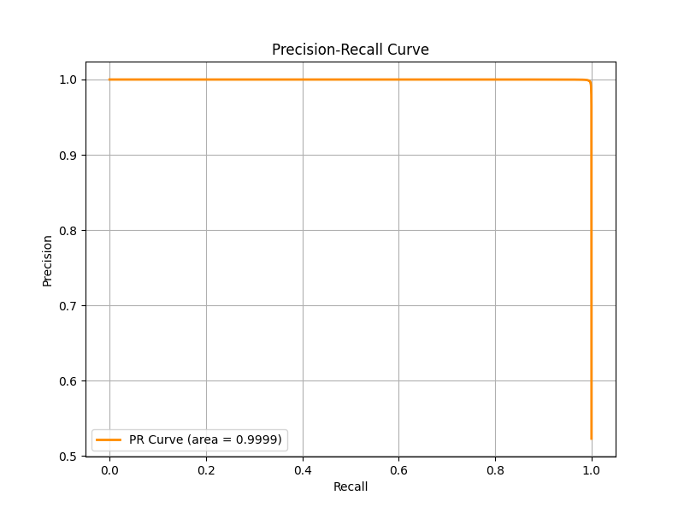
MODERNBERT PRECISION RECALL ANALYSIS
Precision recall curve approaches near perfect behavior
AUC approximately equal to 0.9999
Confirms strong separability on validation data

Slide 62
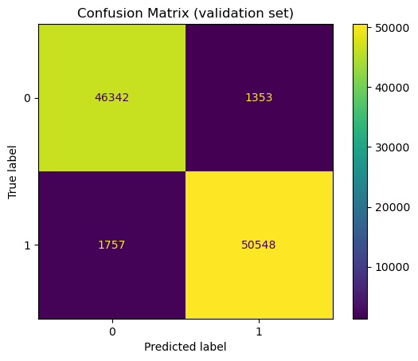
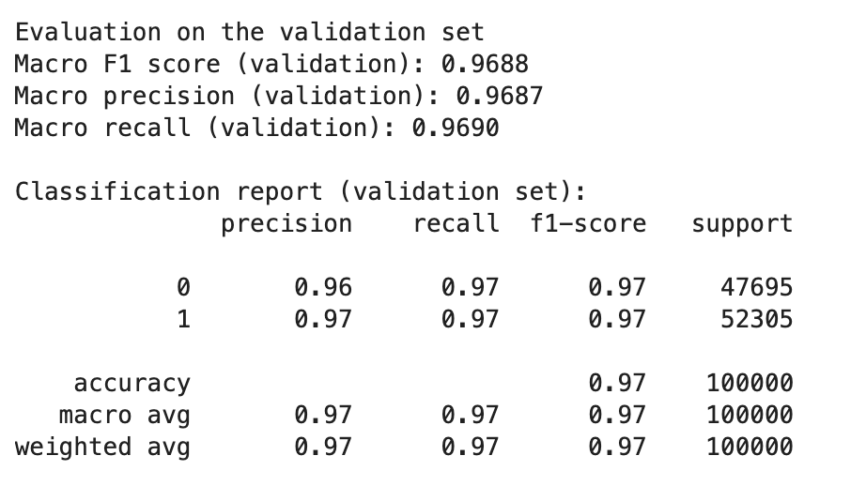
CATBOOST VALIDATION PERFORMANCE
Strong performance on the validation set
Macro F1, macro precision, and macro recall all equal 0.97
Low false positive and false negative rates

Slide 63
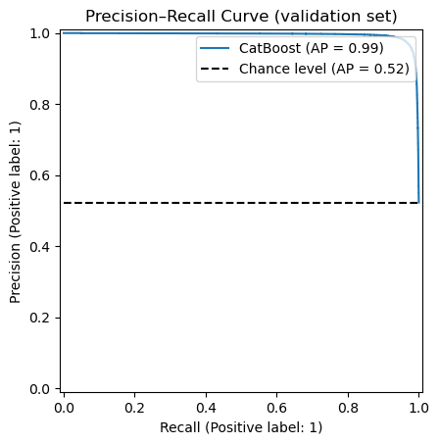
Validation PR curve supports strong class separation
Average precision = 0.99
Clear separation between human-written and machine-generated code (in-distribution)

Slide 64
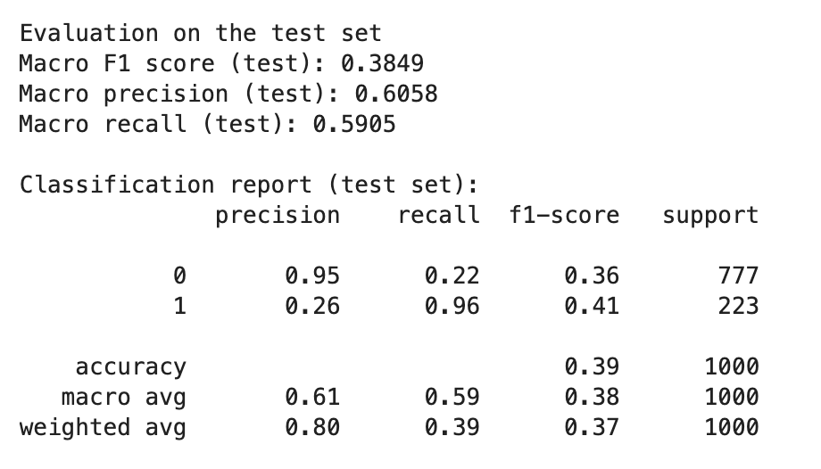
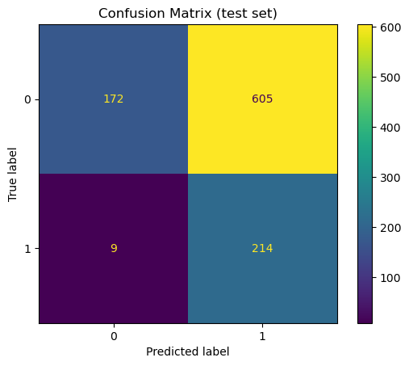
CATBOOST TEST SET GENERALIZATION
Significant performance drop on the test set
Macro F1 decreases to 0.38
Validation vs. test discrepancy
- Indicates difficulty in generalizing to unseen distributions

Slide 65
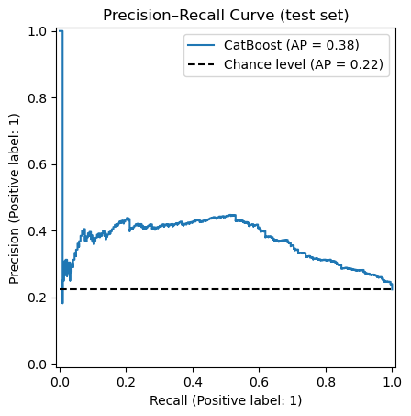
Average precision = 0.38
Only modestly above the chance baseline
The model likely relies on dataset or generator specific artifacts

Slide 66
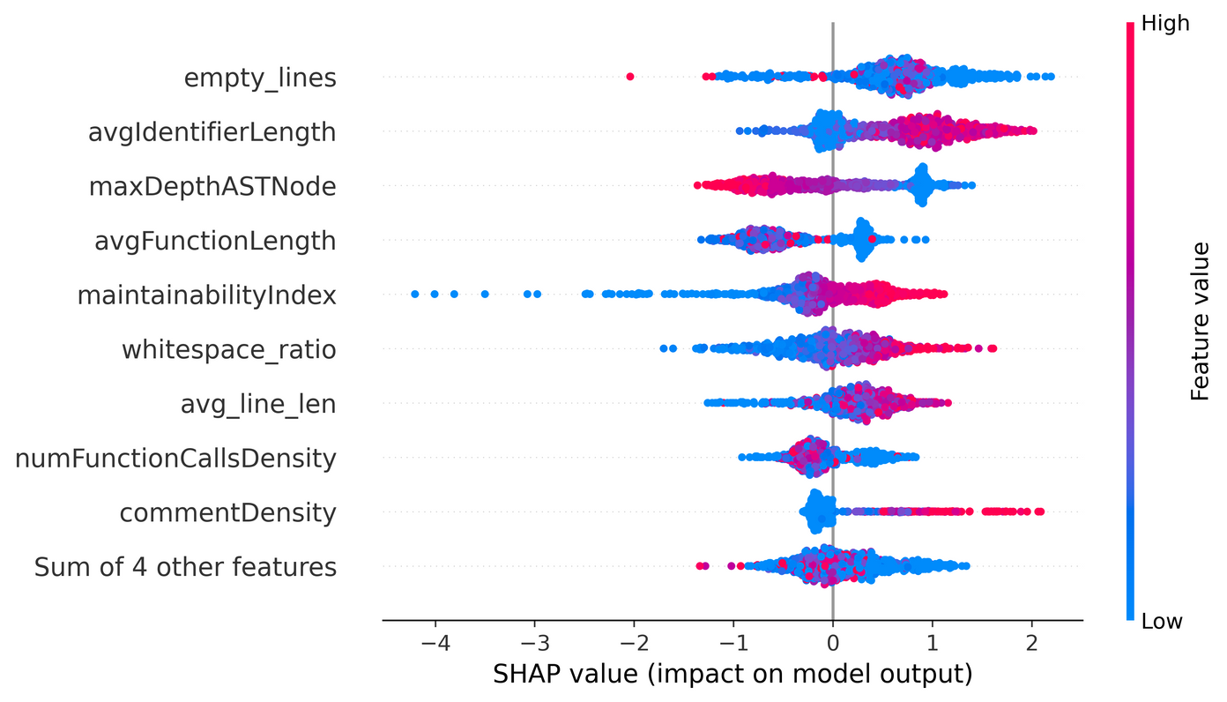
CATBOOST FEATURE IMPORTANCE
SHAP analysis used for interpretability
Number of empty lines identified as the most influential feature
Other important features include average identifier length, AST depth, and average function length

Slide 67
UNIXCODER VALIDATION PERFORMANCE
Validation macro F1 approximately 0.994
Accuracy also approximately 0.994
Precision and recall remain balanced

Slide 68
UNIXCODER TEST SET PERFORMANCE
Public test macro F1 drops to approximately 0.29
Indicates strong overestimation of performance on validation data
Highlights limited robustness to unseen distributions

Slide 69
TF IDF LEXICAL BASELINES VALIDATION
Naive Bayes with unigrams and bigrams achieves macro F1 of approximately 0.83
Linear SVM with up to trigrams improves macro F1 to approximately 0.85
Demonstrates effectiveness of surface level lexical patterns

Slide 70
TF IDF LEXICAL BASELINES TEST PERFORMANCE
TF IDF plus SVM achieves test macro F1 of approximately 0.46
Outperforms all transformer based models on the test set
Suggests improved robustness under distribution shift

Slide 71
GRAPHCODEBERT VALIDATION PERFORMANCE
Validation accuracy approximately 0.995
Macro F1 also approximately 0.995
Training and validation losses remain consistently low

Slide 72
GRAPHCODEBERT TEST SET PERFORMANCE
Test macro F1 decreases to approximately 0.25
Large gap between validation and test performance
Reflects sensitivity to dataset specific artifacts

Slide 73
XGBOOST VALIDATION PERFORMANCE
Macro F1 Score: 0.9831
Accuracy: 0.9831
Highly balanced profile, showing strong discriminative signal within the training domain.

Slide 74
XGBOOST TEST SET PERFORMANCE
Enourmous drop in performance on the unseen test set.
Public Macro F1 Score decreases to approximately 0.27.
Indicates structural features were not robust to distribution shifts in the test data.
Significantly underperformed the simpler TF-IDF + SVM baseline (~0.46 F1), suggesting overfitting to training-specific artifacts.

Slide 75
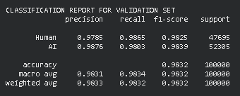
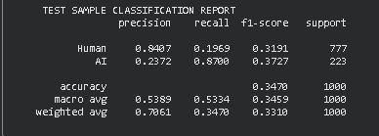
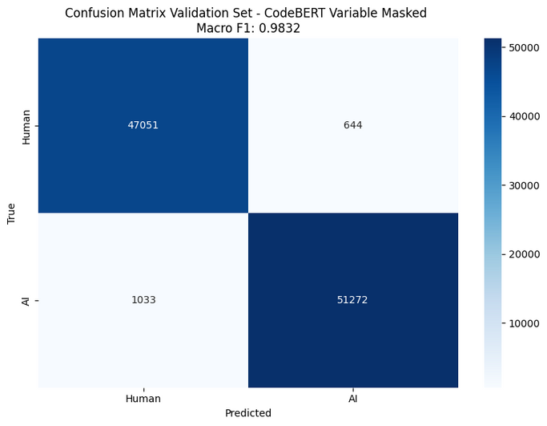
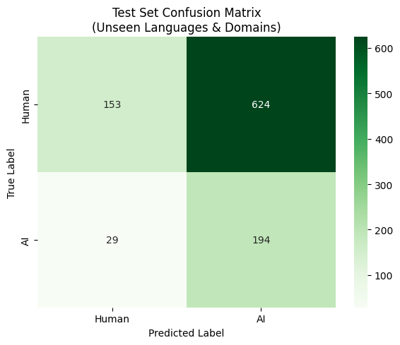
CODEBERT VALIDATION VS TEST SET PERFORMANCE
Validation results show near-perfect classification with 98.3% Macro F1 and balanced precision/recall for both classes.
However, On the test set containing unseen languages, Macro F1 drops to 34.6%.
The confusion matrices reveal the cause: the model over-predicts AI, correctly classifying only 153 of 777 Human samples (19.7% recall) while misclassifying 624 as AI
Which ıs a result of training on balanced data (50/50) but testing on imbalanced data (78/22).

Slide 76
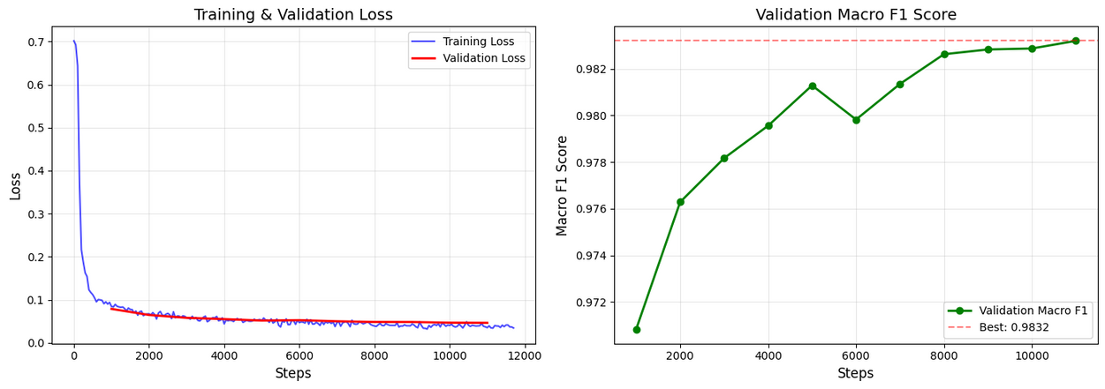
CODEBERT TRAINING CURVES
Training dynamics appear ideal—loss converges smoothly and validation F1 reaches 98.3% with no signs of overfitting.
However, this strong in-distribution performance did not translate to test generalization (34.6% F1), suggesting the model learned language-specific patterns rather than transferable structural features.

Slide 77
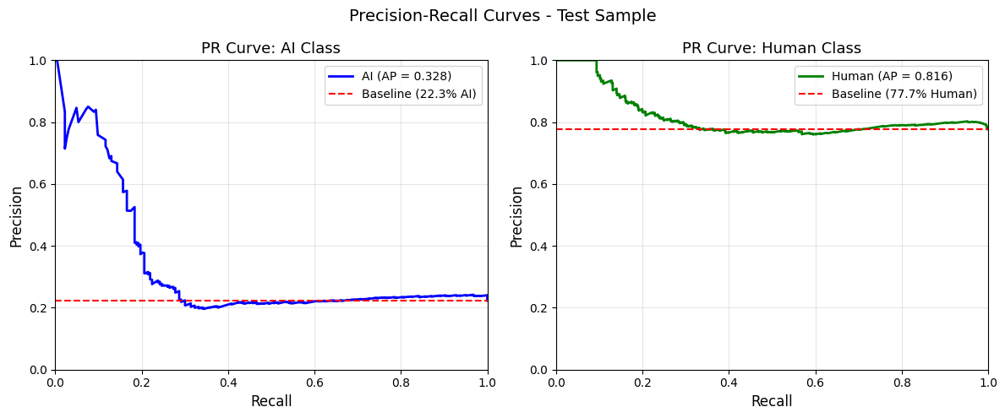
CODEBERT PRECISION AND RECALL CURVES
The PR curves explain the precision-recall tradeoff on unseen languages.
For Human class (AP=0.816), precision remains above baseline even at high recall, showing robust detection.
For AI class (AP=0.328), precision drops
rapidly—achieving 80% precision requires sacrificing recall to just 10%.
This asymmetry reflects the class imbalance: detecting the minority AI
class on imbalanced test data is fundamentally harder.

Slide 78
CROSS MODEL COMPARISON
Encoder based models achieve near ceiling validation scores
All transformer models show severe test performance degradation
Lexical baselines generalize better despite weaker validation scores

Slide 79
KEY RESULTS TAKEAWAYS
Validation performance alone is misleading for this task
Distribution shift is a major challenge in machine generated code detection
Simpler models may offer stronger robustness under unseen conditions

Slide 80
SUBMISSION

Slide 81

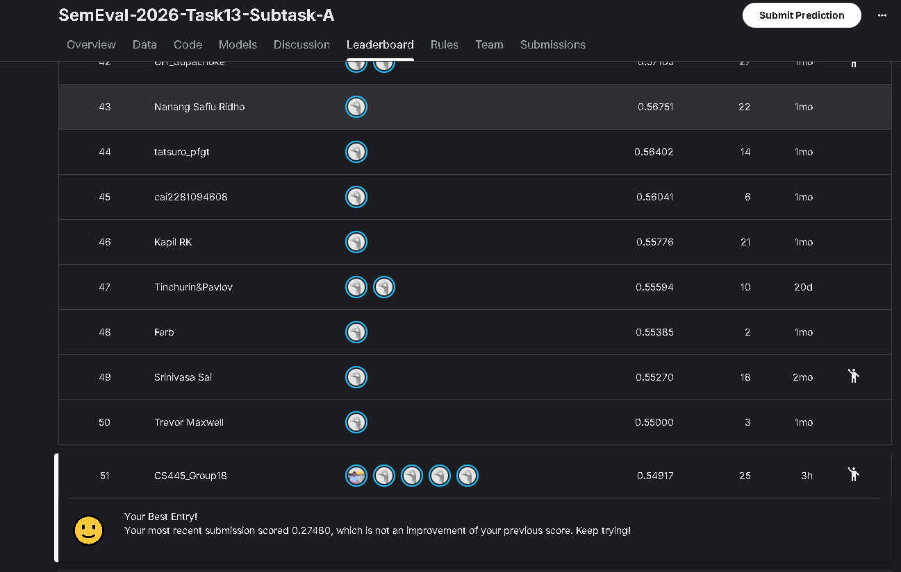

COMPETITION SUBMISSION

Slide 82

COMPETITION SUBMISSION

Slide 83
DISCUSSION

Slide 84
DATASET SELECTION & IMPACT
Dataset choice
Official SemEval-2026 Task 13 Subtask A dataset (mandatory benchmark)
Fixed training, validation, and test splits (competition-compliant)
Impact on performance
Training & validation sets: balanced classes
Test set: highly imbalanced (≈ 22% machine-generated code)
Large validation–test gap reveals severe distribution shift
Key takeaway
Dataset composition strongly affects generalization and evaluation reliability

Slide 85
APPROACH SELECTION
Our approach
Combination of:
Feature-based models (CatBoost, XGBoost)
Neural transformer models (ModernBERT, CodeBERT, UniXcoder)
Advantages
Transformers capture deep semantic and structural patterns
Feature-based models provide interpretability
Disadvantages
High-capacity models overfit to training artifacts
Handcrafted features are brittle across languages and domains

Slide 86
COMPARISON WITH EXISTING SYSTEMS
Observed trend
Complex models perform extremely well on validation
Simple models generalize better on the test set
Test set Macro F1
TF-IDF + Linear SVM: ≈ 0.46 (best overall)
CatBoost: ≈ 0.38
CodeBERT: ≈ 0.346
GraphCodeBERT: ≈ 0.25
UniXcoder: ≈ 0.31
XGBoost: ≈ 0.27

Slide 87
Interpretation
Simpler lexical baselines are less sensitive to generator-specific artifacts
State-of-the-art models struggle under distribution shift
CoDet-M4 and Droid report high validation performance for CatBoost and transformers
We observe the same trend, but show a large validation–test gap under SemEval test conditions

Slide 88
LIMITATIONS
Primary limitation
Poor robustness to unseen distributions
Key issues
Reliance on:
- Formatting patterns
- Language-specific structural features
Structural features (e.g., AST depth, line length) do not transfer well
Class imbalance causes AI over-prediction
- High recall, low precision on test set

Slide 89
POTENTIAL IMPROVEMENTS
With more time and resources
Data augmentation
Variable renaming, indentation variation
Adversarial code generation
Model ensembling
Combine TF-IDF SVM robustness with masked CodeBERT structure modeling
Calibration strategies
Probability calibration
Dynamic thresholding for imbalanced test distributions
Goal
Improve robustness and generalization across unseen domains and generators

Slide 90
DISCUSSION OVERVIEW
Major discrepancy observed between validation and test performance
Nearly all models achieve near perfect validation F1
Performance collapses under out of distribution test conditions
Highlights fundamental challenges in machine generated code detection

Slide 91

VALIDATION VS TEST PERFORMANCE GAP
Validation F1 scores around 0.99 across most models
Test F1 scores drop sharply to approximately 0.25–0.38
Observed for both feature based and transformer based models
Indicates lack of robustness beyond training distribution

Slide 92

THE GENERALIZATION PARADOX
Training and validation sets share generator specific artifacts
High capacity models learn shortcuts instead of true semantics
Memorization of naming conventions, comments, and imports
High in-distribution accuracy does not imply real world reliability

Slide 93
SPURIOUS CORRELATIONS IN TRANSFORMERS
Models rely on superficial stylistic cues
These cues do not transfer to unseen generators or domains
Test set likely contains new languages or newer LLM outputs
Learned patterns fail under distribution shift

Slide 94
SIMPLICITY VS COMPLEXITY
TF IDF plus Linear SVM outperforms transformers on test set
Test F1 around 0.46 for lexical baseline
Transformer models remain below approximately 0.35
Simpler models overfit less under severe distribution shift

Slide 95
WHY LEXICAL MODELS GENERALIZE BETTER
Rely on coarse n gram statistics
Avoid over interpretation of deep syntactic patterns
Less sensitive to generator specific structure
Benefit from implicit regularization

Slide 96
STRUCTURAL FEATURE ENGINEERING LIMITATIONS
CatBoost and XGBoost perform strongly on validation
Test performance remains weak
Structural features vary significantly across languages
Fixed heuristics fail in multilingual and multi domain settings

Slide 97



LANGUAGE SENSITIVITY OF STRUCTURAL FEATURES
Python, Java, and C++ have distinct structural styles
Indentation, line length, and spacing are not invariant
Structural signals do not generalize across languages
Limits applicability of handcrafted features

Slide 98
EFFECT OF SEMANTIC MASKING
Variable masking improves CodeBERT test performance
Forces attention to control flow and syntax
Achieves best test F1 among neural models
Demonstrates value of reducing lexical leakage

Slide 99
ARCHITECTURE DEPENDENT MASKING EFFECTS
Same masking strategy degrades UniXcoder performance
UniXcoder relies on interaction between variables and AST nodes
Indicates architecture specific input dependencies
One size preprocessing does not fit all models

Slide 100
CLASS DISTRIBUTION SHIFT
Training data is approximately balanced
Test data contains fewer machine generated samples
Models over predict AI class in test set
Results in high recall but low precision

Slide 101

CALIBRATION OBSERVATIONS
Threshold calibration partially improves precision
Does not resolve feature representation issues
Highlights mismatch between training and deployment conditions

Slide 102
KEY DISCUSSION TAKEAWAYS
Validation metrics are misleading for this task
Distribution shift is the dominant challenge
Model capacity alone does not ensure robustness
Preprocessing and data diversity are critical

Slide 103
IMPLICATIONS FOR FUTURE WORK
Emphasis on out of distribution evaluation
Training on more diverse generators and languages
Robust feature learning over stylistic cues
Rethinking evaluation protocols for code detection tasks

Slide 104
CONCLUSION

Slide 105
CONCLUSION OVERVIEW
We study SemEval 2026 Task 13 Subtask A
Goal is to distinguish human written code from machine generated code
Multiple approaches are evaluated in a SemEval compliant setting

Slide 106
KEY TAKEAWAYS
All models achieve near perfect validation performance
Severe performance drop occurs on the hidden test set
Distribution shift is the main challenge of this task

Slide 107
FINAL OBSERVATIONS
Simple TF IDF based models generalize better than transformers
Masking improves some models but harms others
Robust generalization remains an open problem

Slide 108
CONTRIBUTIONS

Slide 109
CONTRIBUTIONS
İsa Utku Dursunoğlu: Implemented and fine tuned CodeBERT and UniXcoder with GPTSniffer based and variable masking preprocessing
Filiz Ilgaz Sönmez: Developed the CatBoost baseline and feature extraction pipeline
Enes Çağlar: Implemented and evaluated the ModernBERT encoder based model
Mehmet Barış Baştuğ: Implemented UniXcoder and TF IDF based lexical baselines and performed comparative analysis
Barbaros Yahya: Implemented the XGBoost baseline and conducted performance evaluations

Slide 110
REFERENCES
Feng, Z., Guo, D., Tang, D., Duan, N., Feng, X., Gong, M., Shou, L., Qin, B., Liu, T., Jiang, D., & Zhou, M. (2020). CodeBERT: A pre-trained model for programming and natural languages. In T. Cohn, Y. He, & Y. Liu (Eds.), Findings of the Association for Computational Linguistics: EMNLP 2020 (pp. 1536–1547). Association for Computational Linguistics. https://doi.org/10.18653/v1/2020.findings-emnlp.139
Guo, D., Lu, S., Duan, N., Wang, Y., Zhou, M., & Yin, J. (2022). UniXcoder: Unified cross-modal pre-training for code representation. Proceedings of the 60th Annual Meeting of the Association for Computational Linguistics (Volume 1: Long Papers), 7212–7225. Association for Computational Linguistics. https://doi.org/10.48550/arXiv.2203.03850
Nguyen, P. T., Di Rocco, J., Di Sipio, C., Rubei, R., Di Ruscio, D., & Di Penta, M. (2024). GPTSniffer: A CodeBERT-based classifier to detect source code written by ChatGPT. Journal of Systems and Software, 214, 112059. https://doi.org/10.1016/j.jss.2024.112059
Microsoft. (n.d.). CodeBERT. GitHub. Retrieved November 22, 2025, from https://github.com/microsoft/CodeBERT
Microsoft. (n.d.). Code metrics - Maintainability index range and meaning. Microsoft Learn. Retrieved January 4, 2026, from https://learn.microsoft.com/en-us/visualstudio/code-quality/code-metrics-maintainability-index-range-and-meaning?view=visualstudio
Orel, D., Azizov, D., & Nakov, P. (2025). CoDet-M4: Detecting machine-generated code in multi-lingual, multi-generator, and multi-domain settings. In W. Che, J. Nabende, E. Shutova, & M. T. Pilehvar (Eds.), Findings of the Association for Computational Linguistics: ACL 2025 (pp. 10570–10593). Association for Computational Linguistics. https://doi.org/10.18653/v1/2025.findings-acl.550
Orel, D., Paul, I., Gurevych, I., & Nakov, P. (2025). Droid: A resource suite for AI-generated code detection. In C. Christodoulopoulos, T. Chakraborty, C. Rose, & V. Peng (Eds.), Proceedings of the 2025 Conference on Empirical Methods in Natural Language Processing (pp. 31251–31277). Association for Computational Linguistics. https://doi.org/10.18653/v1/2025.emnlp-main.1593
Warner, B., Chaffin, A., Clavié, B., Weller, O., Hallström, O., Taghadouini, S., Gallagher, A., Biswas, R., Ladhak, F., Aarsen, T., Adams, G. T., Howard, J., & Poli, I. (2025). Smarter, better, faster, longer: A modern bidirectional encoder for fast, memory efficient, and long context finetuning and inference. In Proceedings of the 63rd Annual Meeting of the Association for Computational Linguistics (Volume 1: Long Papers) (pp. 2526–2547). Association for Computational Linguistics. https://aclanthology.org/2025.acl-long.127.pdf

Slide 111
THANK
YOU

